Slide 1
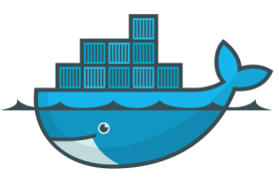
Docker
PIONEER BUSINESS SOLUTIONS

Slide 2
Agenda
Introduction to containers
Containers vs Virtual Machines
Docker
Docker images
DockerHub
Dockerfile
Building an image out of a container
Let’s build an image with Dockerfile!

Slide 3
What is Virtualization?
Virtualization is the technique of importing a Guest operating system on top of a Host operating system.
This technique was a revelation at the beginning because it allowed developers to run multiple operating systems in different virtual machines all running on the same host.
This eliminates the need for extra hardware resource.

Slide 4
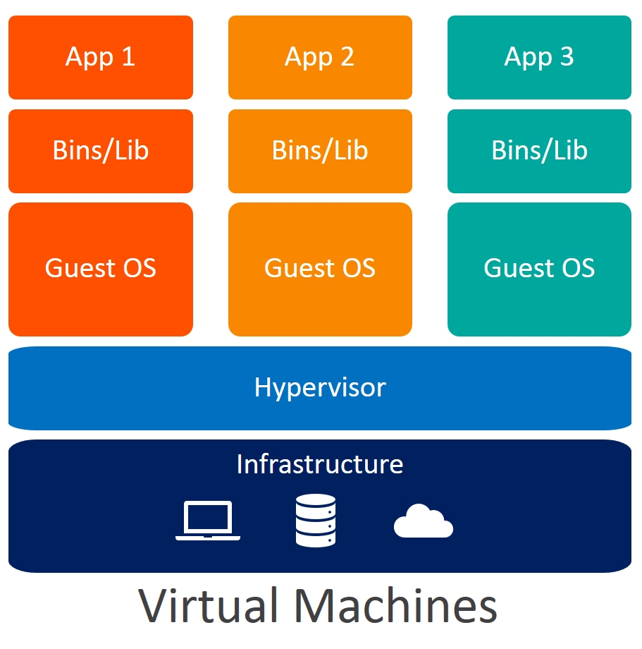
What is a Virtual Machine?
Virtual machines are heavy software packages that provide complete emulation of hardware devices like CPU, Disk and Networking devices.
Virtual machines may also include a complementary software stack to run on the emulated hardware.
These hardware and software packages combined produce a fully functional snapshot of a computational system.

Slide 5
Containerization
Containerization is the packaging together of software code with all it's necessary components like libraries, frameworks, and other dependencies so that they are isolated in their own "container.“
A container is a standard unit of software that packages up code and all its dependencies so the application runs quickly and reliably from one computing environment to another.

Slide 6
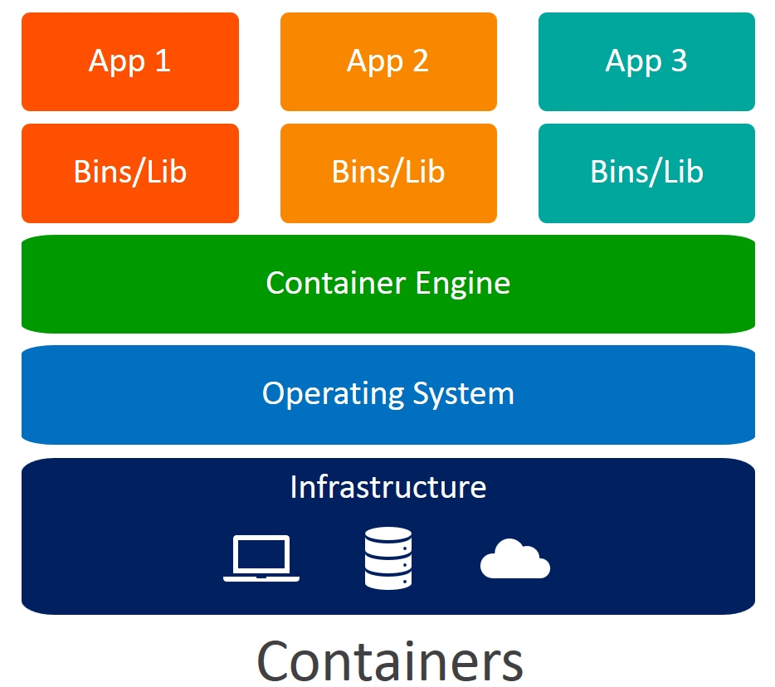
Containerization over Virtualization:

Slide 7
Containerization over Virtualization:
Containers on the same OS kernel are lighter and smaller
Better resource utilization compared to VMs
Boot-up process is short and takes few seconds

Slide 8
Why docker containers are required?
Portability
Isolation
Consistency
Scalability
Collaboration

Slide 9
When to use Containers?
Consider containers in particular if the following is a priority
Start time
Efficiency
Licensing
Code reuse

Slide 10
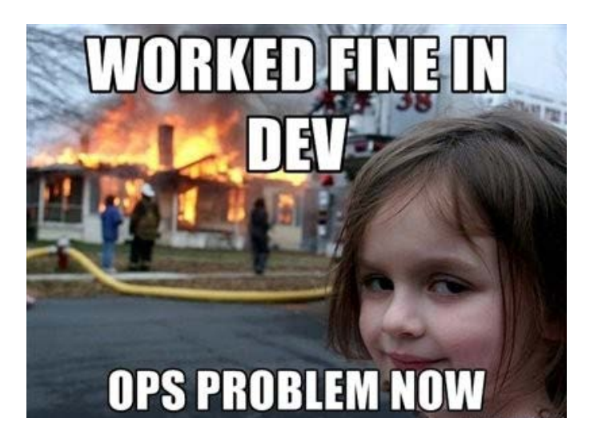
It works on my machine!!!

Slide 11


Slide 12
Docker
Docker is a containerization platform that packages your application and all its dependencies together in the form of Containers to ensure that your application works seamlessly in any environment.
Docker containers that run on Docker Engine:
Standard
Lightweight
Secure

Slide 13
Why Docker
Docker creates simple tooling and a universal packaging approach that bundles up all application dependencies inside a container which is then run on Docker Engine.
Docker Engine enables containerized applications to run anywhere consistently on any infrastructure, solving “dependency issues” for developers and operations teams, and eliminating the “it works on my laptop!” problem.

Slide 14
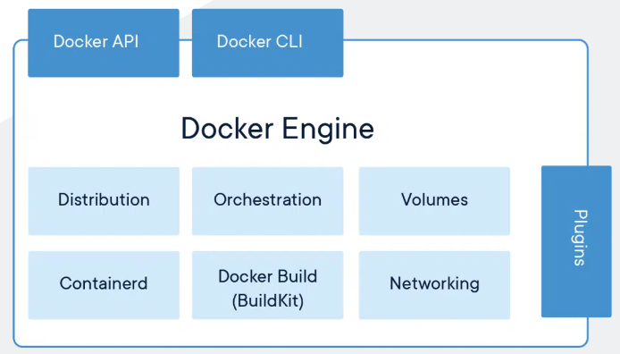
Docker Engine

Slide 15
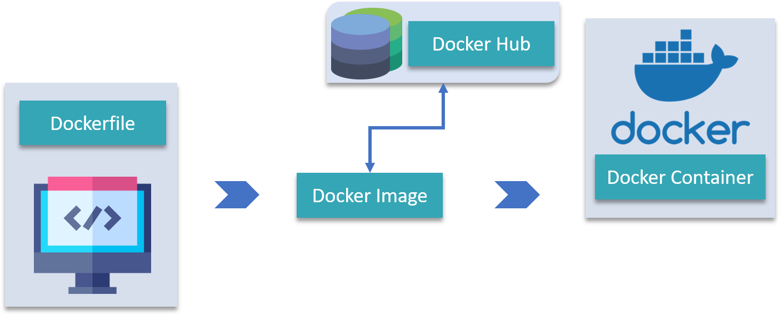
Terminologies of Docker
Docker Image
Dockerfile
Docker Containers
Docker Hub
Docker Compose
Docker Client
Docker Daemon

Slide 16
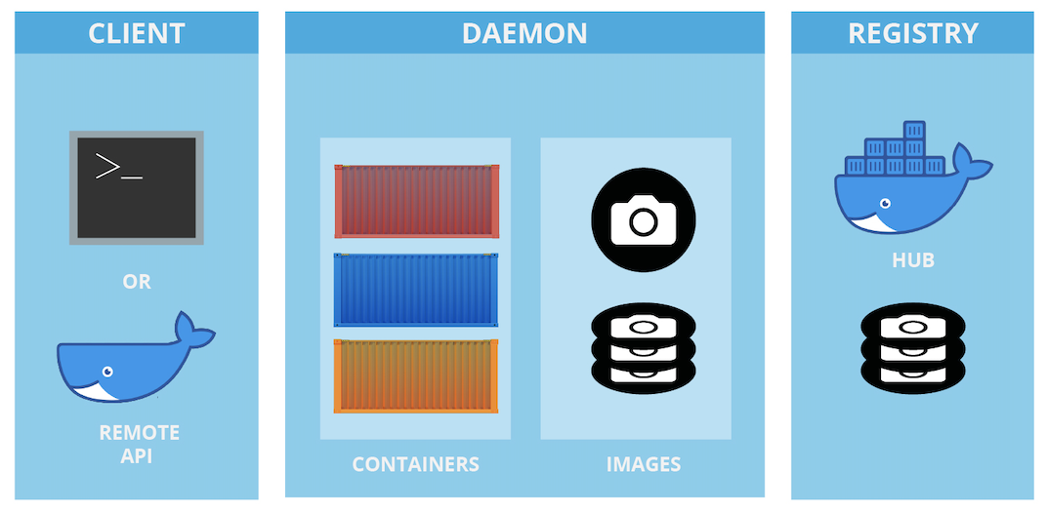
Docker Architecture

Slide 17
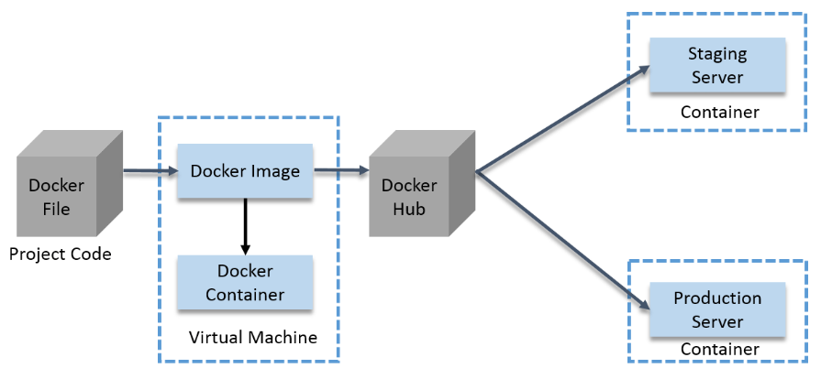
How a Docker Container Works?

Slide 18
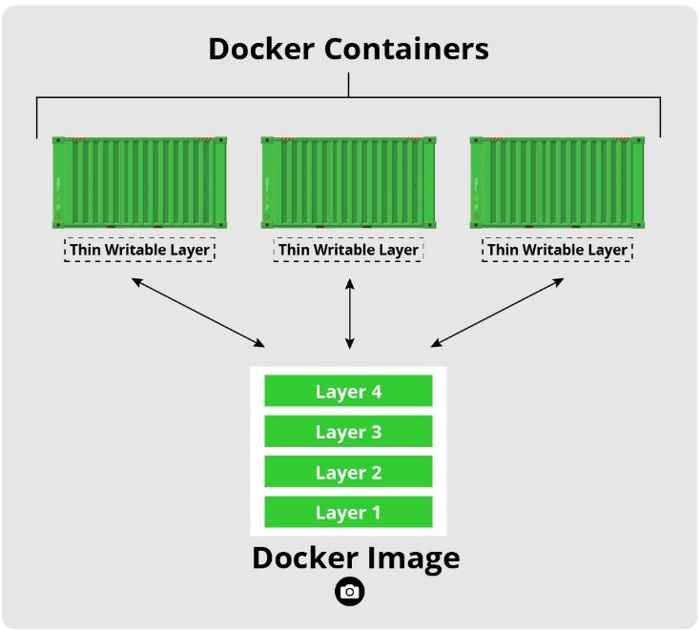
Docker Images & Containers

Slide 19
Docker Networking
Docker Networking offers flexible and powerful networking capabilities for containerized applications, enabling efficient communication and connectivity between containers and the external network.
Some key concepts and features of Docker Networking:
Containers
Docker Network
Bridge Network
Overlay Network
Container-to-Container Communication
Exposing Ports
DNS Resolution
Docker Compose

Slide 20
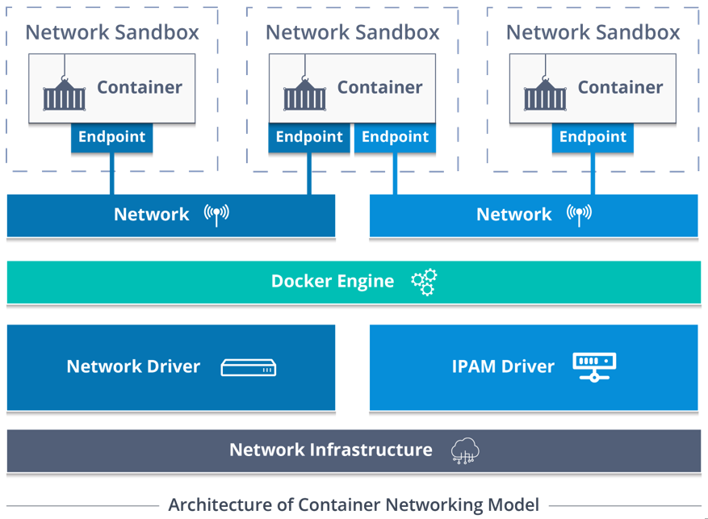
Docker Networking Architecture

Slide 21


Slide 22
THANK YOU

